Slide 1
Business In Toronto
Which to do?

Slide 2
Introduction
Problem Understanding:
What Business to open in Toronto City?
Business Understanding
As we know Toronto is a city is Canada and also it is very good for opening business. One can very profit by establishing a business at this place.
Fact : Toronto is the largest population centre in Ontario by population (5,429,524).
Analytical Approach
We will use the data from Wikipedia as Toronto data is not readily available and some json files to collect the data required an find out the least and the most frequent business in that area and after all the evaluation we will predict or give the result for the problem

Slide 3
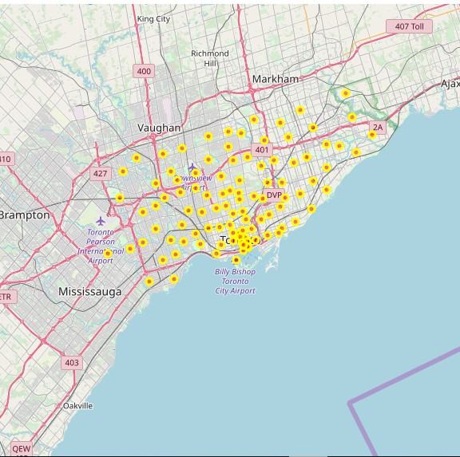
Data collection
Map of Toronto

Slide 4
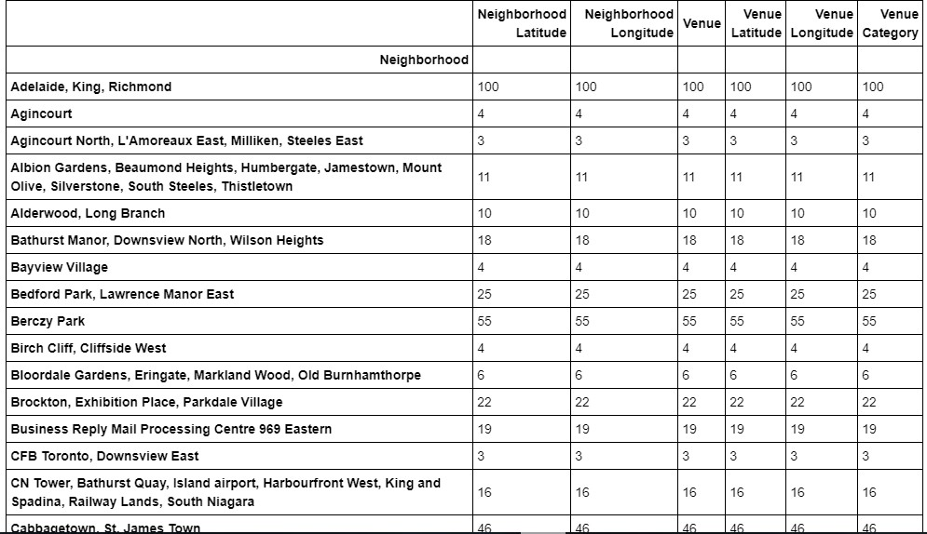
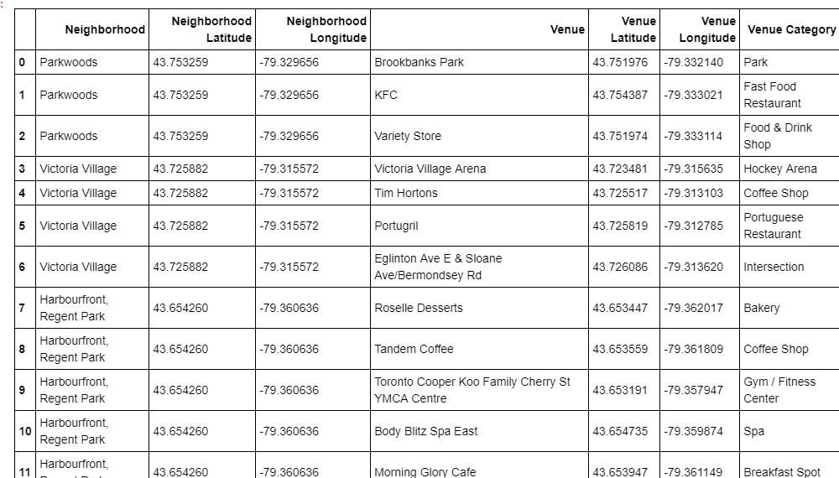
Venues
Number Of Venues
List Of Venues

Slide 5

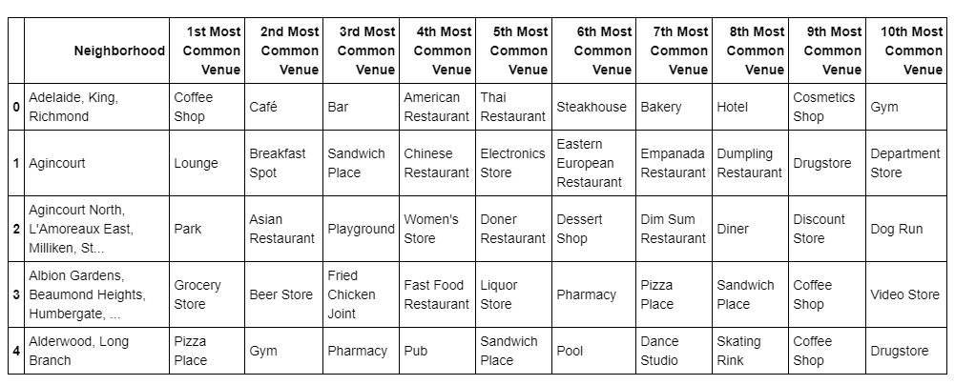

List of top venues
This is the list of top venues which we are not going to start business with

Slide 6
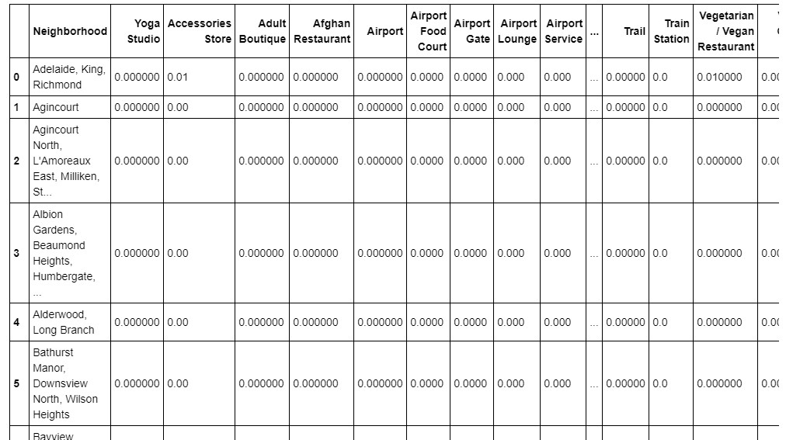
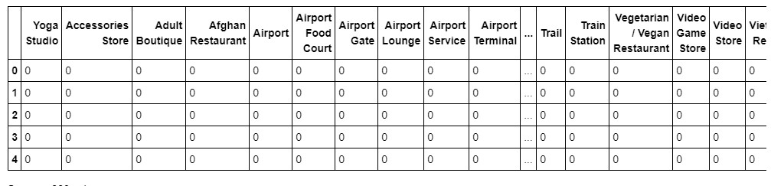
List of Venues with Least Frequency

Slide 7
Now we have seen that business-like yoga accessories, Adult boutique etc. are the least common venues or business in the site But the business Accessories Store, Vegetarian Restaurant, Women Store have a frequency of 0.01 hence maybe we do not prefer these.

Slide 8
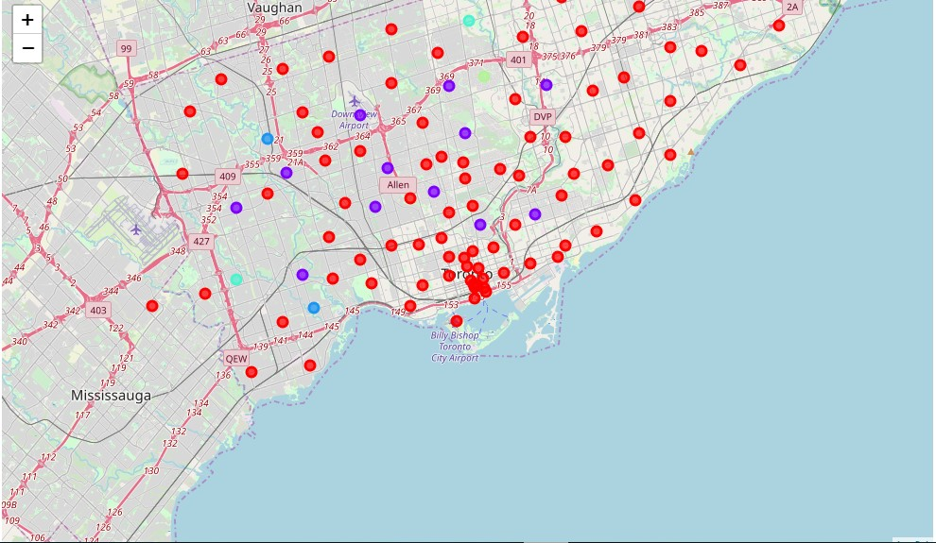
Clustering And Segmentation
We are using k=5,6 clusters in this model. After clustering the map will be like this

Slide 9
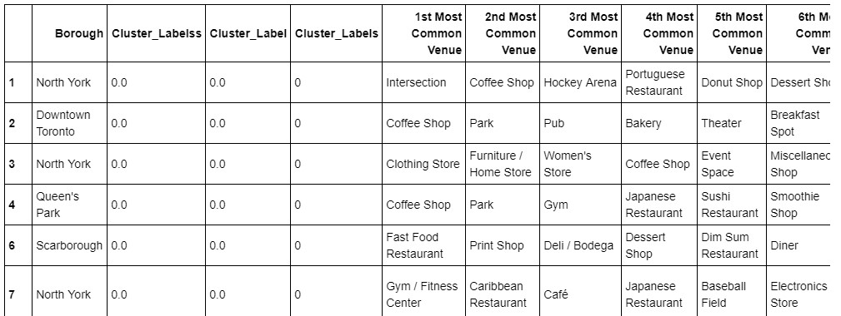
Evaluation of clusters

Slide 10
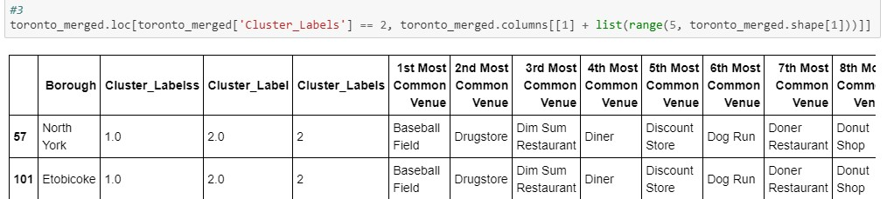
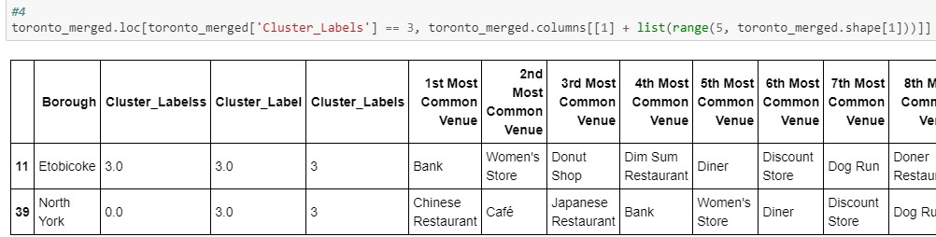

Slide 11
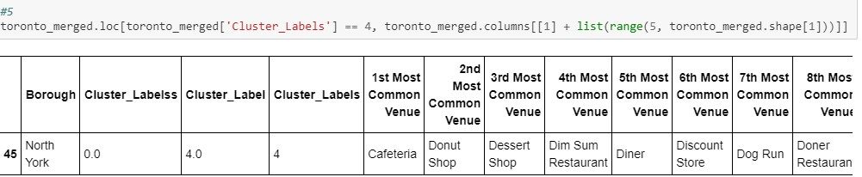

Slide 12
Result
From the data analysing and visualization, we came to know that the business-like yoga and accessories, Acc. store, Adult Boutique, Afghan Restaurant, Vegetarian/Vegan Restaurant, Video game store, wine bar, Women’s store had very low approx. equal to zero frequency. So, these types of business will be recommended on this site.
However, Acc. Store, Wine Bar and Women Store had a frequency of 0.01 hence rest will be much better option
Now the business-like Coffee shop, lounge, Park, grocery store, cafe, Asian restaurant, pharmacy etc (refer table) is not recommended as it is most commonly held business in the site.

Slide 13
References:
https://en.wikipedia.org/wiki/Toronto
https://labs.cognitiveclass.ai/tools/jupyterlab/lab/tree/labs/DS0103EN/DS0103EN-2-2-1-From-Requirements-to-Collection-v2.0.ipynb
Foursquare API

